Slide 1

INSTITUTE UIE
DEPARTMENT ACADEMIC UNIT-1
Bachelor of Engineering (Computer Science & Engineering)
Subject Name Semi Conductor Physics
Subject Code 23SPH-143
Prepared By
Navjeet Kaur
Experiment-2.1.3
Types of Transistor and its Configuration.
DISCOVER . LEARN . EMPOWER

Slide 2
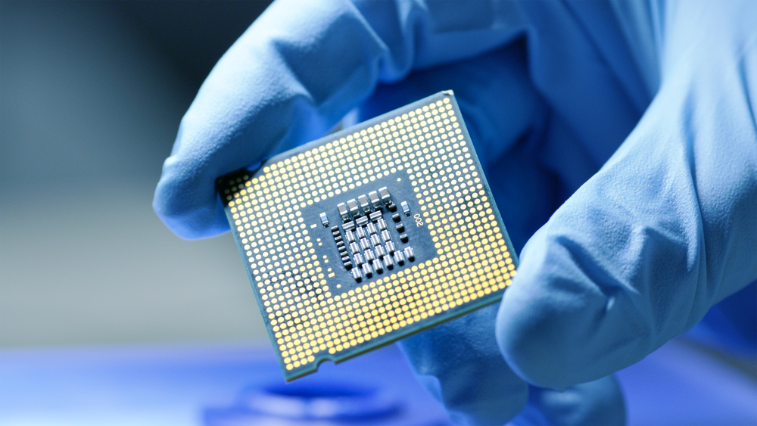
Course Objectives
S. No. | Objectives
1 | To understand the basic materials and properties of semiconductors.
2 | Understand the basic of semiconductor and components like diode, transistor, FET, MOSFET and Energy Sources.
3 | To give knowledge about semiconductor physics and discus working and applications of basic devices, including p-n junctions, BJTs and FETs.
https://www.iqsdirectory.com/resources/everything-you-ever-wanted-to-know-about-semiconductors/

Slide 3

Course Outcomes
S.NO | Description | Blooms’ Taxonomy Level
CO1 | To apply the knowledge of basic semiconductor material physics and understand fabrication processes. | EASY
CO2 | To understand the characteristics of different electronic devices such as diodes, transistors. | MEDIUM
CO3 | To derive the relationships between the parameters in diode, FET, configurations of Transistor and MOSFETs. | MEDIUM
CO4 | To describe the working and design considerations for the various photonic devices like photo detectors, solar-cells and LEDs. | HARD
CO5 | To provide problem solving experience and learning of concepts through it in semiconductor physics. | HARD
https://lot.dhl.com/5-things-the-current-semiconductor-slowdown-tells-us-about-the-global-economy/

Slide 4
What is Electronics
Electronics is the science of how to control electric energy, energy which the electrons have a fundamental role.
Its also deals with electrical circuits that involve active electrical components such as vacuum tubes, transistors, diodes and integrated circuits, and associated passive electrical components and interconnection technologies.
You will work with a number of basic electronic components when building electronic circuits, including resistors, capacitors, diodes, transistors, and integrated circuits. Here is a brief overview of the functions of each of these basic electronic components.
Notes:
Fig-3

Slide 5
Content
n-p-n transistor
p-n-p transistor
Fact about Transistor Terminals
Configuration of Transistor
CE Configuration
CB Configuration
CC Configuration

Slide 6
Introduction to Transistor
There are three leads in a transistor viz., emitter, base and collector terminals. However, when a transistor is to be connected in a circuit, we require four terminals; two for the input and two for the output.
This difficulty is overcome by making one terminal of the transistor common to both input and output terminals. The input is fed between this common terminal and one of the other two terminals. The output is obtained between the common terminal and the remaining terminal.

Slide 7
Transistor Configuration
Accordingly; a transistor can be connected in a circuit in the following three ways:
• Common Base Connection
• Common Emitter Connection
• Common Collector Connection
Each circuit connection has specific advantages and disadvantages. It may be noted here that regardless of circuit connection, the emitter is always biased in the forward direction, while the collector always has a reverse bias.

Slide 8
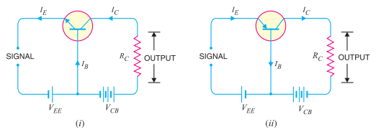
Common Base Connection
In this circuit arrangement, input is applied between emitter and base and output is taken from collector and base.
Here, base of the transistor is common to both input and output circuits and hence the name common base connection.
In Fig. 1 (i), a common base npn transistor circuit is shown whereas Fig. 1 (ii) shows the common base pnp transistor circuit.
Figure 1: Common Base Configuration
(Source: Principles of Electronics, V K Mehta , Rohit Mehta, 12/e , S. Chand Publishing)

Slide 9
Current amplification factor (α)
It is the ratio of output current to input current. In a common base connection, the input current is the emitter current IE and output current is the collector current IC.
The ratio of change in collector current to the change in emitter current at constant collector base voltage VCB is known as current amplification factor.
This is achieved by making the base thin and doping it lightly. Practical values of α in commercial transistors range from 0.9 to 0.99.
α=(∆I_{C})/(∆I_{E} ) at constant V_{CB} (1)

Slide 10
Expression for collector current
The whole of emitter current does not reach the collector. It is because a small percentage of it, as a result of electron-hole combinations occurring in base area, gives rise to base current.
Total collector current,
IC = α I_{E} + I_{leakage} (2)
it is clear that if I_{E} = 0 (i.e., emitter circuit is open), a small leakage current still flows in the collector circuit.

Slide 11
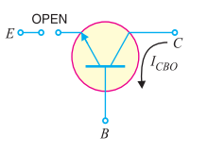
Expression for collector current
This I_{leakage} is abbreviated as I_{CBO}, meaning collector-base current with emitter open. The I_{CBO} is indicated in Fig. 2.
Figure 2: Leakage current I_{CBO} in Common Base Configuration
(Source: Principles of Electronics, V K Mehta , Rohit Mehta, 12/e , S. Chand Publishing)

Slide 12

Expression for collector current
IC = α IE + ICBO (3)
IE = IC + IB (4)
IC = α (IC + IB) + ICBO (5)
or
IC (1 − α) = α IB + ICBO (6)
Thus,
$I_{C}=\frac{α}{1−α} I_{B}+\frac{I_{CBO}}{1−α}$(7)

Slide 13
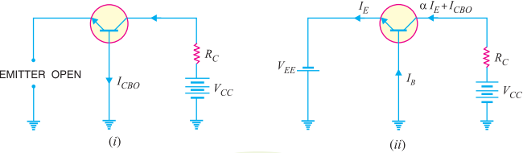
Concept of I_{CBO}
In CB configuration, a small collector current flows even when the emitter current is zero.
This is the leakage collector current (i.e. the collector current when emitter is open) and is denoted by I_{CBO}.
When the emitter voltage V_{EE} is also applied, the various currents are as shown in Fig. 3 (ii).
Figure 3: Concept of Leakage current ICBO in Common Base Configuration
(Source: Principles of Electronics, V K Mehta , Rohit Mehta, 12/e , S. Chand Publishing)

Slide 14
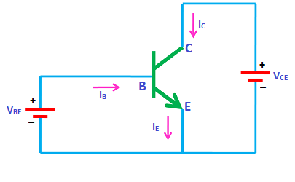
Common Emitter Configuration
In common emitter configuration, base is the input terminal, collector is the output terminal and emitter is the common terminal for both input and output.
That means the base terminal and common emitter terminal are known as input terminals whereas collector terminal and common emitter terminal are known as output terminals.
Fig.1 Common Emitter Configuration
(Source: https://www.physics-and-radio-electronics.com/electronic-devices-and circuits/transistors/bipolarjunctiontransistor/commonemitterconfiguration.htm)

Slide 15
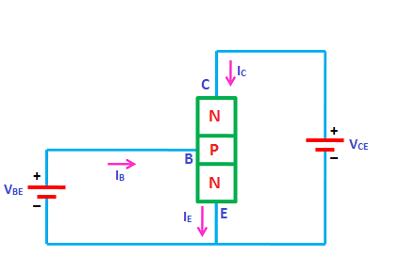
Common Emitter Configuration
In common emitter configuration, the emitter terminal is grounded so the common emitter configuration is also known as grounded emitter configuration.
Sometimes common emitter configuration is also referred to as CE configuration, common emitter amplifier, or CE amplifier. The common emitter (CE) configuration is the most widely used transistor configuration.
Fig.2 Common Emitter Configuration
(Source: https://www.physics-and-radio-electronics.com/electronic-devices-and circuits/transistors/bipolarjunctiontransistor/commonemitterconfiguration.html)

Slide 16
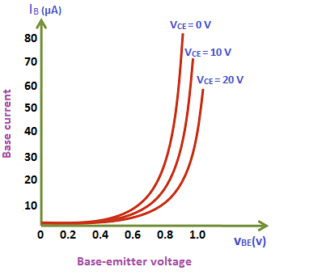
Input Characteristics
The input characteristics describe the relationship between input current or base current (I_{B}) and input voltage or base-emitter voltage (V_{BE}).
To determine the input characteristics, the output voltage V_{CE} is kept constant at zero volts and the input voltage V_{BE} is increased from zero volts to different voltage levels. For each voltage level of input voltage (V_{BE}), the corresponding input current (I_{B}) is recorded.
Fig.3 Input characteristics of CE Configuration
(Source: https://www.physics-and-radio-electronics.com/electronic-devices-and circuits/transistors/bipolarjunctiontransistor/commonemitterconfiguration.html)

Slide 17
Input Characteristics
The output voltage (V_{CE}) is increased from zero volts to certain voltage level (10 volts) and the output voltage (V_{CE}) is kept constant at 10 volts. While increasing the output voltage (V_{CE}), the input voltage (V_{BE}) is kept constant at zero volts.
After we kept the output voltage (V_{CE}) constant at 10 volts, the input voltage V_{BE} is increased from zero volts to different voltage levels. For each voltage level of input voltage (V_{BE}), the corresponding input current (I_{B}) is recorded.

Slide 18
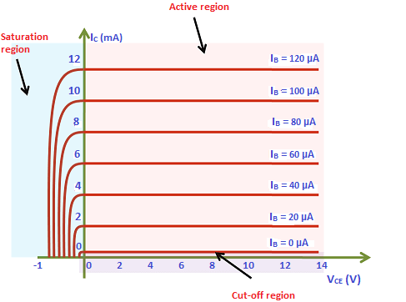
Output Characteristics
The output characteristics describe the relationship between output current (I_{C}) and output voltage (V_{CE}).
First, draw a vertical line and a horizontal line. The vertical line represents y-axis and horizontal line represents x-axis. The output current or collector current (I_{C}) is taken along y-axis (vertical line) and the output voltage (V_{CE}) is taken along x-axis (horizontal line).
To determine the output characteristics, the input current or base current I_{B} is kept constant at 0 μA and the output voltage V_{CE} is increased from zero volts to different voltage levels. For each level of output voltage, the corresponding output current (I_{C}) is recorded.
Fig.4 output characteristics of CE Configuration
(Source: https://www.physics-and-radio-electronics.com/electronic-devices-and circuits/transistors/bipolarjunctiontransistor/commonemitterconfiguration.html)

Slide 19
Output Characteristics
A curve is then drawn between output current I_{C} and output voltage V_{CE} at constant input current I_{B} (20 μA). This region is known as the active region of a transistor. In this region, emitter-base junction is forward biased and the collector-base junction is reverse biased.
This steps are repeated for higher fixed values of input current I_{B} (I.e. 40 μA, 60 μA, 80 μA and so on).
When output voltage V_{CE} is reduced to a small value (0.2 V), the collector-base junction becomes forward biased. This is because the output voltage V_{CE} has less effect on collector-base junction than input voltage V_{BE}.
As we know that the emitter-base junction is already forward biased. Therefore, when both the junctions are forward biased, the transistor operates in the saturation region. In this region, a small increase in output voltage V_{CE} will rapidly increases the output current I_{C}.

Slide 20


Transistor parameters
Dynamic input resistance (r_{i}):-Dynamic input resistance is defined as the ratio of change in input voltage or base voltage (V_{BE}) to the corresponding change in input current or base current (I_{B}), with the output voltage or collector voltage (V_{CE}) kept at constant. In CE configuration, the input resistance is very low.
Dynamic output resistance (r_{o}) :-Dynamic output resistance is defined as the ratio of change in output voltage or collector voltage (V_{CE}) to the corresponding change in output current or collector current (I_{C}), with the input current or base current (I_{B}) kept at constant. In CE configuration, the output resistance is high.

Slide 21
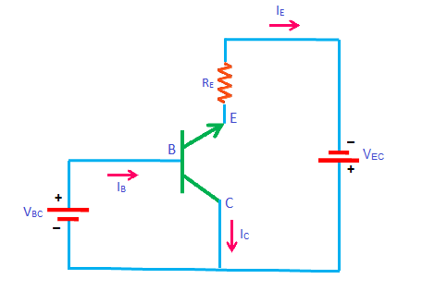
Common Collector Configuration
In this configuration, the base terminal of the transistor serves as the input, the emitter terminal is the output and the collector terminal is common for both input and output. Hence, it is named as common collector configuration. The input is applied between the base and collector while the output is taken from the emitter and collector.
In common collector configuration, the collector terminal is grounded so the common collector configuration is also known as grounded collector configuration.
Fig.1 Common Collector Configuration
(Source:https://www.physics-and-radio-electronics.com/electronic-devices-and-circuits/transistors/bipolarjunctiontransistor/commoncollectorconfiguration.html)

Slide 22
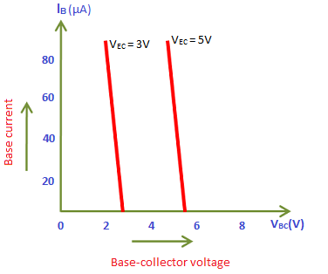
Input Characteristics
The input characteristics describe the relationship between input current or base current (IB) and input voltage or base-collector voltage (VBC).
First, draw a vertical line and a horizontal line. The vertical line represents y-axis and horizontal line represents x-ax
The input current or base current (IB) is taken along y-axis (vertical line) and the input voltage or base-collector voltage (VBC) is taken along x-axis (horizontal line).
Fig.3 Input characteristics of CC Configuration
(Source:https://www.physics-and-radio-electronics.com/electronic-devices-and-circuits/transistors/bipolarjunctiontransistor/commoncollectorconfiguration.html)

Slide 23
Curve between input current IB and input voltage VBC
To determine the input characteristics, the output voltage VEC is kept constant at 3V and the input voltage VBC is increased from zero volts to different voltage levels. For each level of input voltage VBC, the corresponding input current IB is noted. A curve is then drawn between input current IB and input voltage VBC at constant output voltage VEC (3V).
After we kept the output voltage VEC constant at 5V, the input voltage VBC is increased from zero volts to different voltage levels. For each level of input voltage VBC, the corresponding input current IB is noted. A curve is then drawn between input current IB and input voltage VBC at constant output voltage VEC (5V).
This process is repeated for higher fixed values of output voltage (VEC).

Slide 24
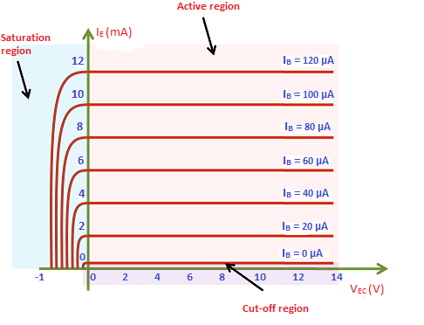
Output Characteristics
The output characteristics describe the relationship between output current or emitter current (IE) and output voltage or emitter-collector voltage (VEC).
First, draw a vertical line and a horizontal line. The vertical line represents y-axis and horizontal line represents x-axis.
The output current or emitter current (IE) is taken along y-axis (vertical line) and the output voltage or emitter-collector voltage (VEC) is taken along x-axis (horizontal line).
Fig.4 output characteristics of CE Configuration
(Source:https://www.physics-and-radio-electronics.com/electronic-devices-and-circuits/transistors/bipolarjunctiontransistor/commoncollectorconfiguration.html)

Slide 25
Curve between output current IE and output voltage VEC
In common collector configuration, if the input current or base current is zero then the output current or emitter current is also zero. As a result, no current flows through the transistor. So the transistor will be in the cutoff region.
If the base current is slightly increased then the output current or emitter current also increases. So the transistor falls into the active region. If the base current is heavily increased then the current flowing through the transistor also heavily increases. As a result, the transistor falls into the saturation region.

Slide 26
Curve between output current IE and output voltage VEC
In common collector configuration, if the input current or base current is zero then the output current or emitter current is also zero. As a result, no current flows through the transistor. So the transistor will be in the cutoff region.
If the base current is slightly increased then the output current or emitter current also increases. So the transistor falls into the active region. If the base current is heavily increased then the current flowing through the transistor also heavily increases. As a result, the transistor falls into the saturation region.

Slide 27
Curve between output current IC and output voltage VCE
A curve is then drawn between output current I_{C} and output voltage V_{CE} at constant input current I_{B} (20 μA). This region is known as the active region of a transistor. In this region, emitter-base junction is forward biased and the collector-base junction is reverse biased.
This steps are repeated for higher fixed values of input current I_{B} (I.e. 40 μA, 60 μA, 80 μA and so on).
When output voltage V_{CE} is reduced to a small value (0.2 V), the collector-base junction becomes forward biased. This is because the output voltage V_{CE} has less effect on collector-base junction than input voltage V_{BE}.
As we know that the emitter-base junction is already forward biased. Therefore, when both the junctions are forward biased, the transistor operates in the saturation region.

Slide 28
Summary
Transistor Connection
Common Base Connection
Current amplification factor (α)
Expression for collector current.

Slide 29
Frequently Asked Questions
Explain different type of transistor connection
Explain Common Base Connection
Explain Current amplification factor (α)
Derive the expression for collector current.
What is meant by leakage current.

Slide 30

LEARNING OUTCOMES
To make students understand
Transistor Connection
Common Base Connection
Current amplification factor (α)
Expression for collector current.

Slide 31
References
Text Books:
Microelectronics Circuits, Adel S. Sedra and Kenneth Carless Smith, Oxford University Press.
Millman’s Integrated Electronics, Jacob Millman, Christos Halkias, Chetan Parikh, McGraw Hill Education.
Digital Logic & Computer Design, M. Morris Mano, Pearson
Reference Books:
Principles of Electronics, V K Mehta , Rohit Mehta, 12/e , S. Chand Publishing
Solid State Electronic Devices,6th Edition, Ben Streetman, Sanjay Banerjee
Electronic Principle, Albert Paul Malvino.
Electronics Circuits:Discrete & Integrated, D Schilling C BeloveTApelewiczRSaccardi.
Microelectronics, Jacob Millman, Arvin Grabel.
Electronics Devices &Circuits,S. Salivahanan, N. Suresh Kumar,A. Vallavaraj
Electronic Devices & Circuit Theory, 11th Edition, Robert L. Boylestad,LouisNashelsky

Slide 32
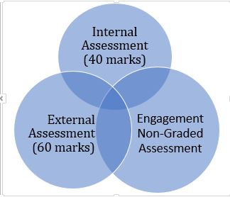
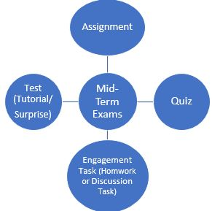
Assessment Pattern

